Slide 1
Liam whelan
By Culann

Slide 2
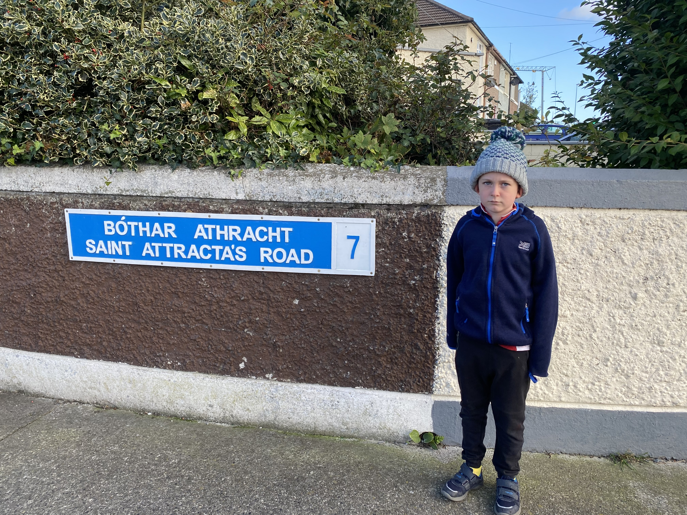
Liam Whelan was born on 1st April 1935 in Dublin.
He was born in Cabra on Saint Attracta’s Road

Slide 3
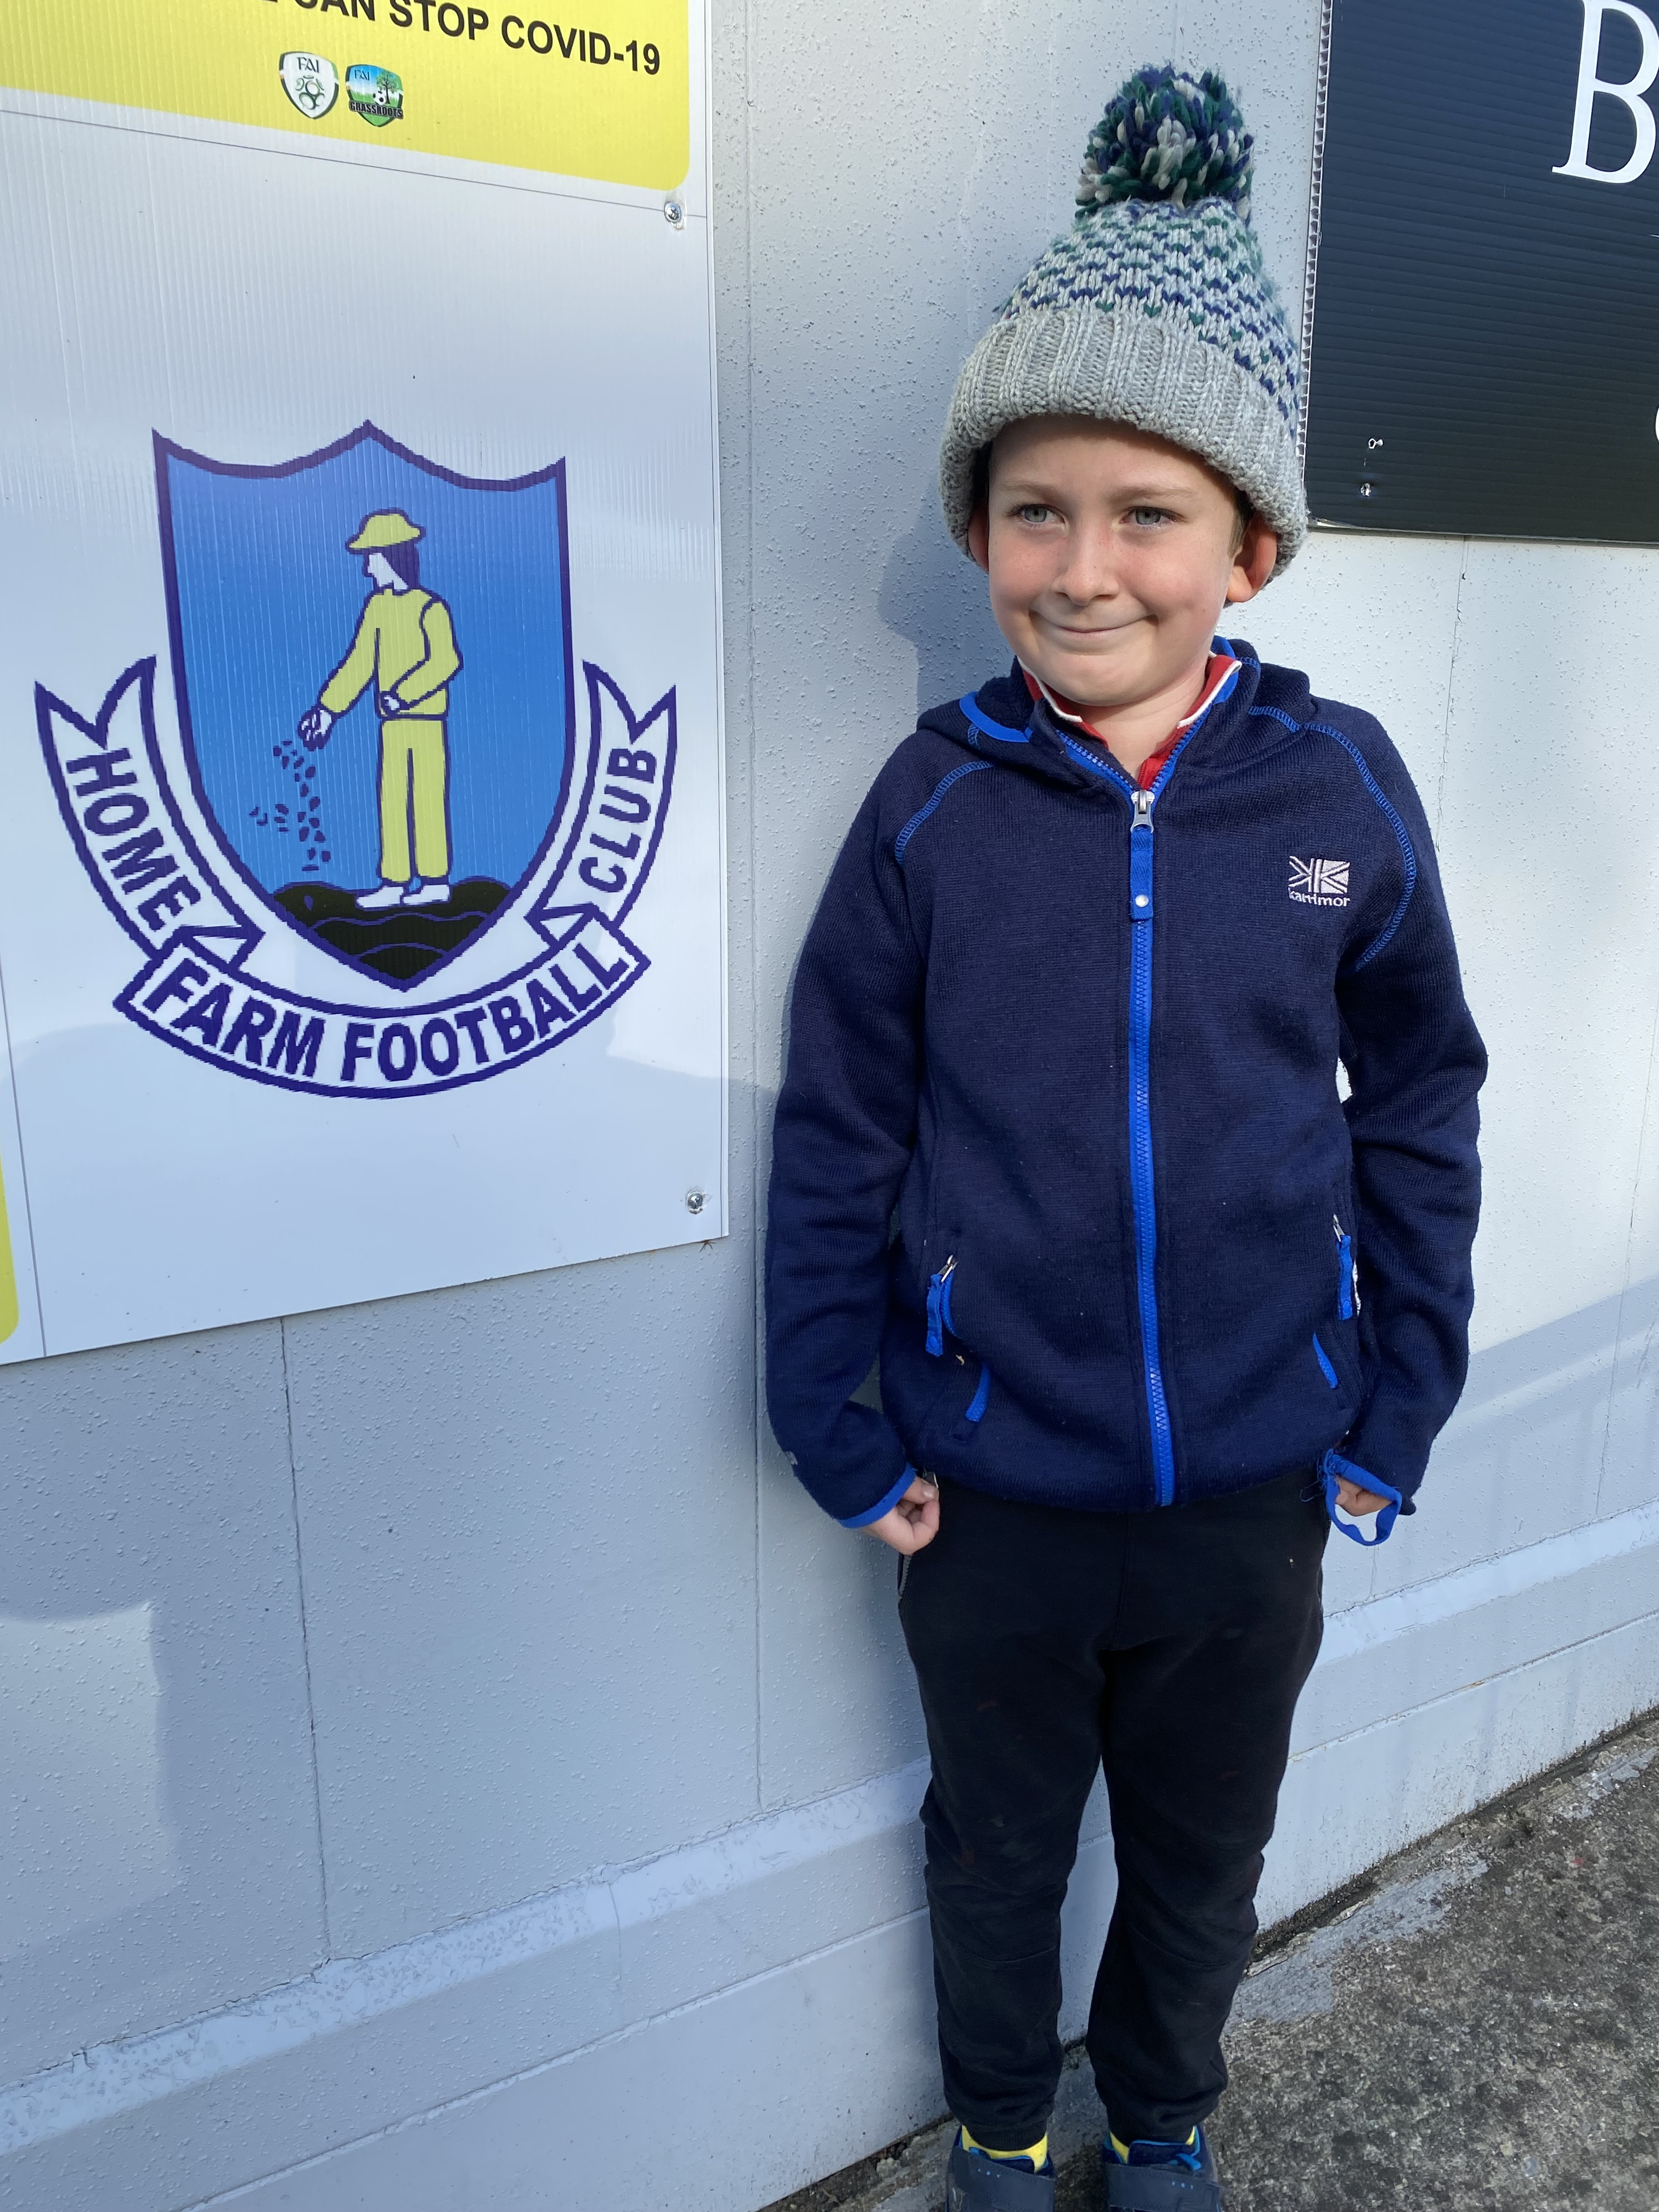
Liam played soccer for Home Farm in Drumcondra.

Slide 4
He played for Home Farm until the age of 18 and moved to Manchester United.

Slide 5
He died on the 6th of February 1958 at the age of 22.
He died in the Munich air disaster when 23 died and 21 survived.

Slide 6
There is a bridge in Cabra named after him.

Slide 7
