Slide 1
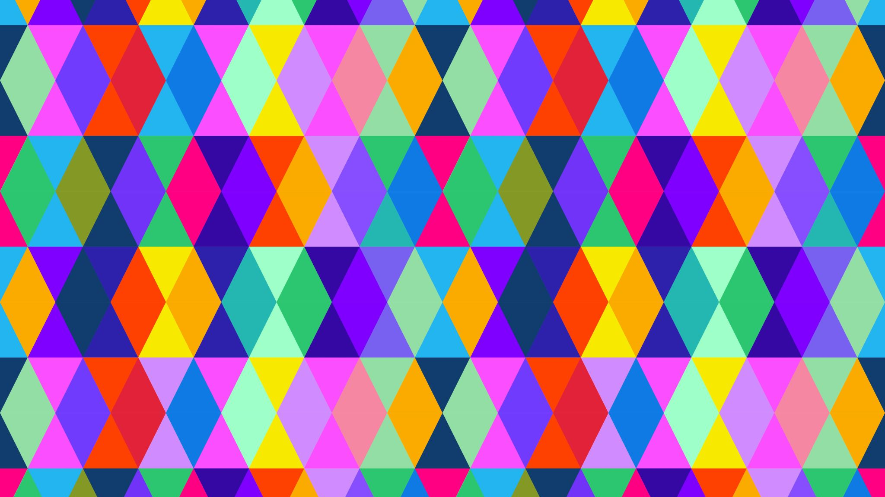
Colours
Vibrant and pop

Slide 2
How colourS happen
Color is the aspect of things that is caused by differing qualities of light being reflected or emitted by them.

Slide 3
Colourful pictures
Mixing colours
Colour wheel

Slide 4
Seeing colours
Dogs can only see in black and white.
The human eye has three types of cone cells, each of which can see about 100 different colour shades.
Animals can only see a few colours.

Slide 5
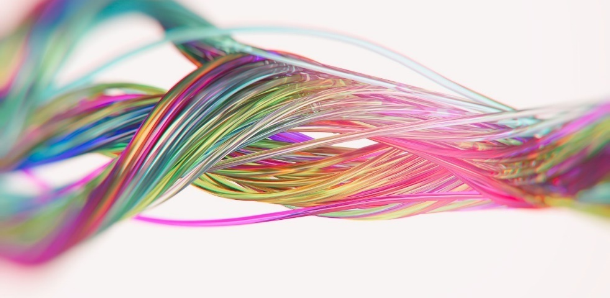
More colourful pictures

Slide 6
The end

