Slide 1
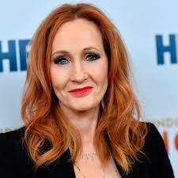
J.K. Rowling
By Sam leigh

Slide 2
facts
J.K. Rowling wrote her first story at the age of 6 called 'Rabbit' and her first novel at the age of 11.
Rowling completed the first draft of Harry Potter and the Philosopher’s Stone in 1996 on a manual typewriter.
The author and her iconic character share the same birthday, July 31.
The game of Quidditch was actually inspired by Rowling’s favourite sport - basketball.

Slide 3
J.K. Rowling’s first Harry Potter manuscript was rejected by 12 publishing houses before being picked up by Bloom
Rowling is a big fan of the block-building game Minecraft and often plays it with her son David.
Rowling initially penned the ideas for Harry Potter on a napkin!
The idea for Harry Potter came to Rowling while riding on the train to London from Manchester in 1990. The train had been delayed and she came up with the idea for a story which took place in a secret school of wizardry and had a young boy wizard as the main hero. The main characters and ideas branched off from there and she was soon writing the first book.

