Slide 1
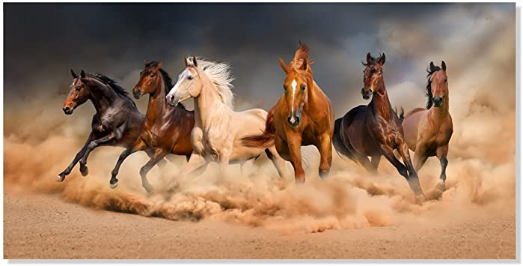
Rosa Bacik
Horses

Slide 2
Facts
Horses were domesticated from wild animals by humans at least 5000 years ago.
They are large, strong animals, and some breeds are used to pull heavy loads.
Racehorses can gallop up to 30 miles an hour.
A male horse is a stallion, and a female horse is a mare. A young horse is a foal.
Horses have hooves which need protection by horseshoes from hard or rough ground.
Can live to between 25 and 30 years old.

Slide 3
The horse skeleton averages 205 bones.
The body part that is called a horse's "knee" is actually made up of the carpal bones that correspond to the human wrist.
A horse also has no muscles in its legs below the knees.

Slide 4
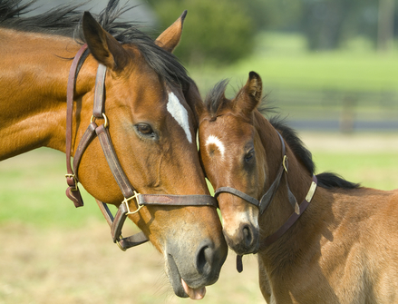
Foals are capable of standing and running within a short time following birth.
Foals are usually born in the spring.
Horses are usually put under saddle and trained to be ridden between the ages of two and four.

