Slide 1
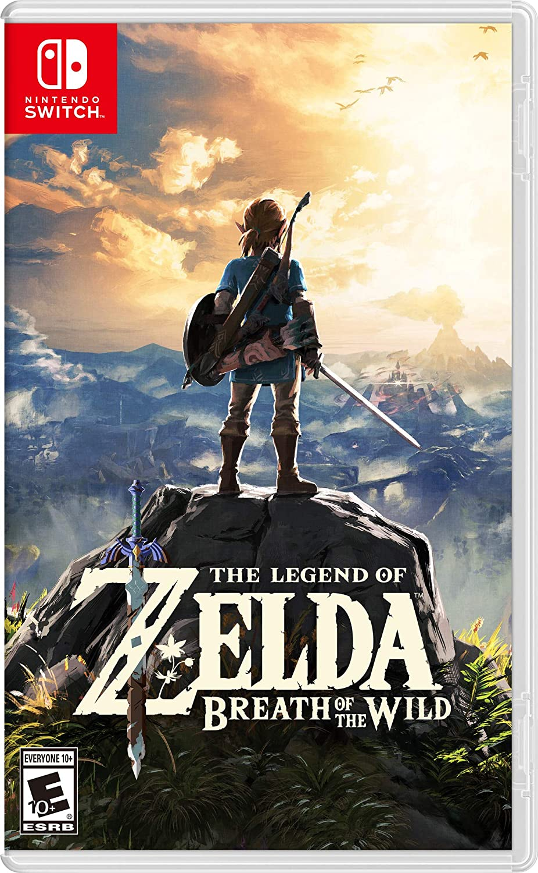
Zelda
By Evin Bacik

Slide 2
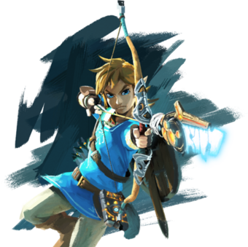
What is Zelda?
Zelda is a game on Nintendo switch
You play Link and you have to rescue Princess Zelda
You go on an adventure where you have to fight monsters and solve puzzles
The further you get the stronger Link gets with heart containers, stamina vessels and weapons

Slide 3
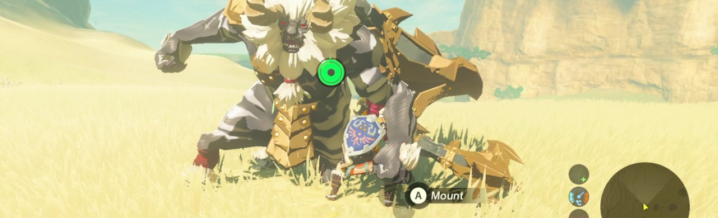
Why I Like Zelda
I like Zelda because
You can collect lots of different things
You can explore the beautiful world of Hyrule
It has a very interesting storyline
You can visit lots of different towns
There’s lots of action and puzzles

Slide 4
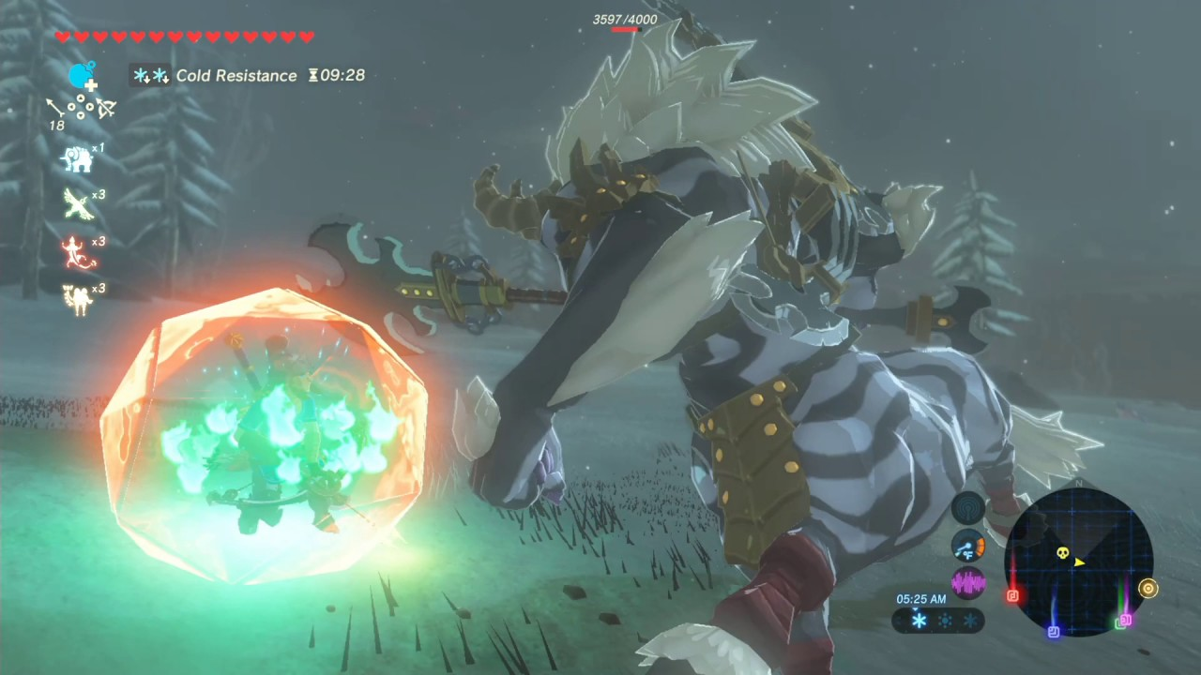
Where I am in Zelda
I have 14 heart containers
I have freed all the divine beasts
I have just got the master sword
I have defeated a white maned Lynel
I still need to get 6 more memories and then defeat calamity Ganon and rescue Princess Zelda

Slide 5
Video of Me Shooting a Silver Maned Lynel

