Slide 1
Tin Whistles
Ruth Kenny

Slide 2
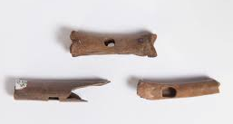
History of Tin whistles
The Tin whistle developed from the flageolet. A flageolet is an old woodwind instrument like a recorder.
The tin whistle today comes from a wider family of fipple flutes which have been seen in many designs and countries throughout the world.
Fragments or pieces of 12th-century Norman bone whistles have been found in Ireland.

Slide 3
Names for Tin Whistles
Penny whistle,
Flageolet,
English flageolet,
Scottish penny whistle,
Tin flageolet,
Irish whistle,
Belfast Hornpipe,
Feadóg stáin (or feadóg)
Clarke London Flageolet

Slide 4
Types of Tin Whistles
Different types of Tin Whistles
An image of some Tin Whistles
Clarke Pennywhistle Key of D.
Woody Irish whistle
Clarke whistle Green
Feadog Brass -whistle
Flageolet Brass whistle
Clarke Sweetone D
Walton’s Brass Pennywhistle C

Slide 5
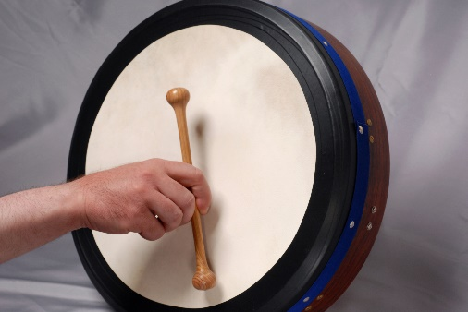
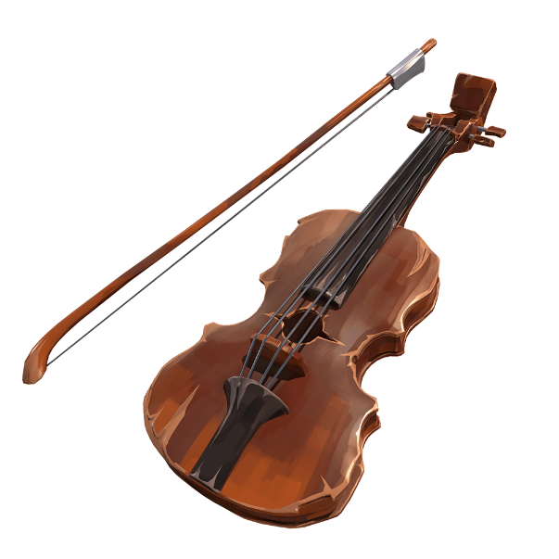
The Tin Whistle and traditional Irish Music
The tin whistle is very popular with traditional Irish Musicians.
Most Irish musicians started learning the tin whistle before starting to learn to another instrument such as the bodhran, fiddle or the box

Slide 6
Ruth Playing the Lilting Banshee

Slide 7
The Tin Whistle and traditional Irish Music
The tin whistle is very popular with traditional Irish Musicians.
Most Irish musicians started learning the tin whistle before starting to learn to another instrument such as the bodhran, fiddle or the box

