Slide 1
Sharks
By Aisling Phelan

Slide 2
Sharks
By Aisling Phelan

Slide 3
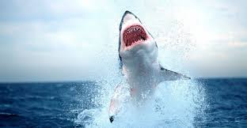
Sharks come in many different sizes, like hammerhead, tigershark and even dog fish…..but there is nothing like a Great White Shark!

Slide 4
Movie - “Jaws”
The shark in the 1975 movie “Jaws” was a great white shark

Slide 5
Facts about sharks.
Sharks have no bones
Sharks have good eyesight.
The skin of a shark feels like sandpaper.
Sharks go into a trance when they are turned on their back.
Sharks have been around for a long time (455 million years ago).
Blue Sharks are really blue.
Not all sharks have the same type of teeth.
Each whale shark’s pattern is as unique as a fingerprint.

Slide 6
Reasons I like sharks!
They are cool!
They are interesting.
They are brave.
They are in a great movie.

Slide 7
Sharks come in many different sizes, like hammerhead, tigershark and even dog fish…..but there is nothing like a Great White Shark!

Slide 8
Movie - “Jaws”
The shark in the 1975 movie “Jaws” was a great white shark

Slide 9
Facts about sharks.
Sharks have no bones
Sharks have good eyesight.
The skin of a shark feels like sandpaper.
Sharks go into a trance when they are turned on their back.
Sharks have been around for a long time (455 million years ago).
Blue Sharks are really blue.
Not all sharks have the same type of teeth.
Each whale shark’s pattern is as unique as a fingerprint.

Slide 10
Reasons I like sharks!
They are cool!
They are interesting.
They are brave.
They are in a great movie.

