Slide 1
My Babi Milka
By Claire Letso

Slide 2
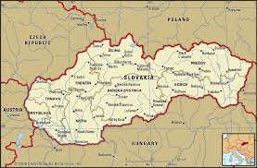
Facts
Babi means grandma in Slovak.
My Babi was born in a place called Nova Lubovna near the beautiful mountains.

Slide 3
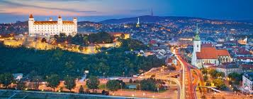
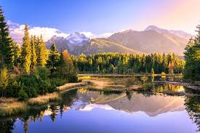
Facts About Slovakia
The capital city of Slovakia is Bratislava.
Mountains near my Babi’s place are called the Tatra Mountains, which divide Slovakia from Poland.

Slide 4
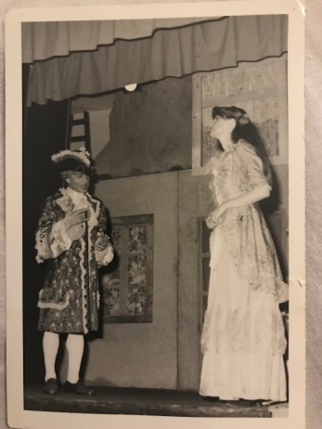
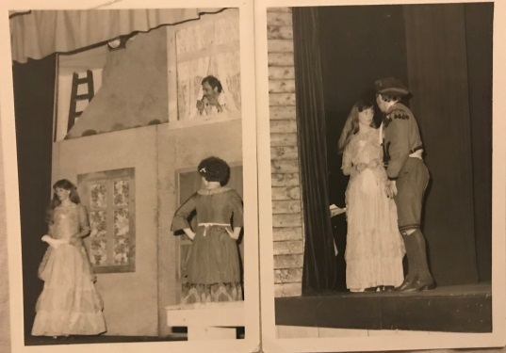
Family Life and Hobbies
Babi enjoyed playing guitar, skiing and she was an actress in her local theatre.
Including my Babi, there were 10 siblings and life was cheerful and fun with them around.

Slide 5
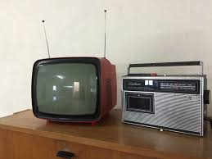
TV and Radio
Babi was born during the time when TV and radio stations first started broadcasting.

Slide 6
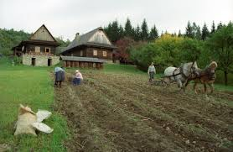
Homemade Organic Food
All the food was from the farm and fields that belonged to my Babi’s parents and they used to make homemade butter, bread and all the food necessary for feeding a big family.

Slide 7
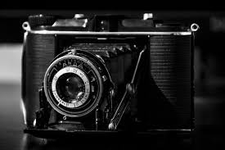
Taking Pictures Facts
When Babi was young, taking pictures, especially family pictures, was not as easy as it is today.
There were only two people in the village who owned photography equipment and you had to book them way ahead of time to come take pictures of you and your family.

Slide 8
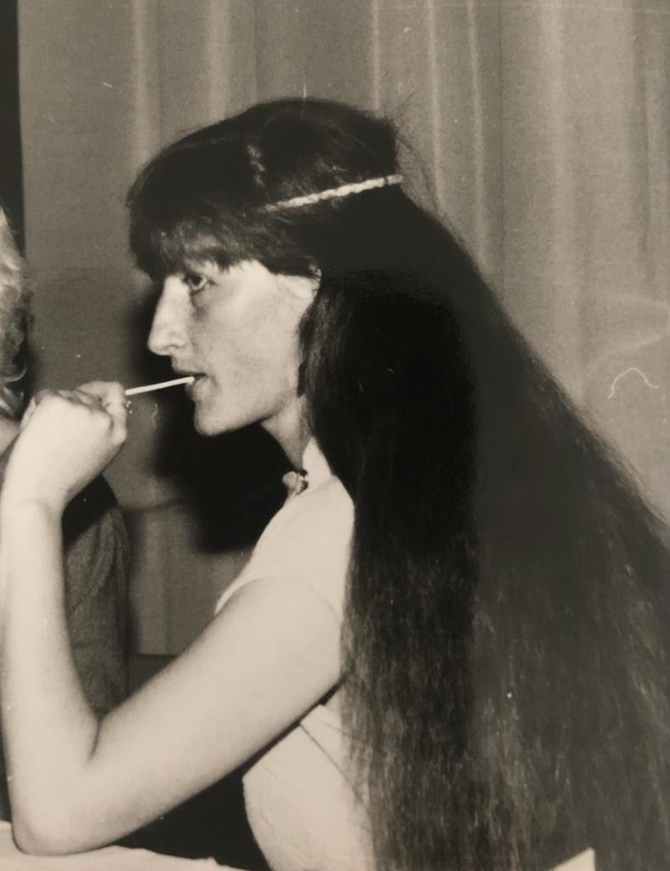
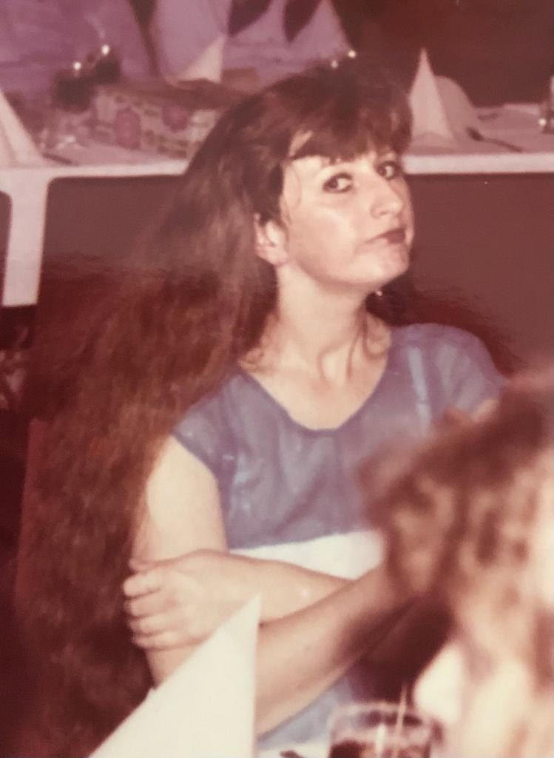
This is my Babi when she was young.

Slide 9
I hope you enjoyed learning about my Babi’s live in Slovakia.
Thank you for listening.

