Slide 1
Liam Whelan
By Aisling

Slide 2
Young Liam
Liam Whelan born April 1935.He lived in Cabra .Then he moved to Manchester in 1953.He had 6 siblings and 7 if you count him.

Slide 3
Older Liam
Liam Whelan died February 1958.He died in the Munich air disaster. Some of his friends also were there too, like Harry Gregg and Jackie Blanchflower.

Slide 4
Facts about Liam Whelan
He played for a teem called man united.
He died in the Munich air disaster.
He was born in Cabra.
His manager was Matt Busby.
His nickname was Billy Whelan.

Slide 5
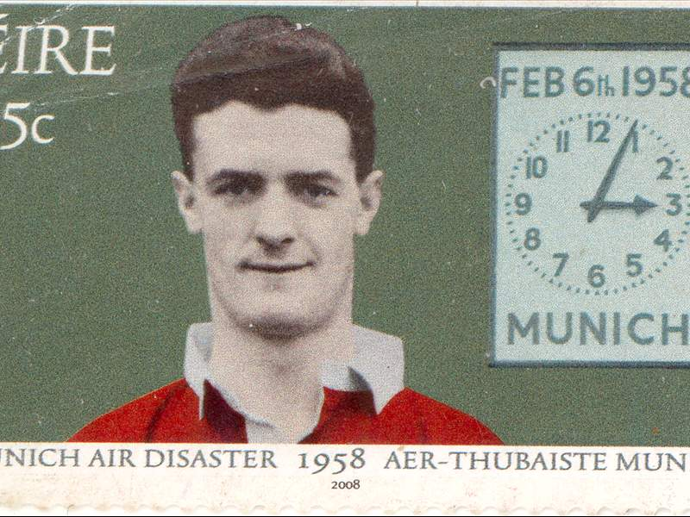
Liam Whelan Stamp and Bridge

Slide 6
The End

