Slide 1
Alice Guy Blache
By Aisling + Blue

Slide 2
Alice’s Life
Alice(born July 1 1873) was the first women to be a movie director (I still like Steven Spielberg better). She was born in France. Sadly she died on March 24 19 68 she died of the flu):

Slide 3
Facts About Alice
Her most famous movie is named House of Cards.
Steven Spielberg is still the best.
She had 2 kids.
Her husband left her when she was having her second child.
She was born in Paris.

Slide 4
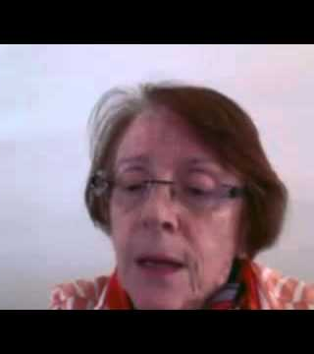
This is Alice before she died
This is her a few years before she died

Slide 5
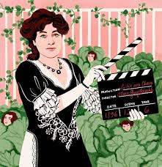
A panting of her
This is my favourite panting of Alice

Slide 6
This is Alice Guy-Blacé’s first film. https://www.youtube.com/watch?v=CYbQO6pwuNs
It was made in 1896, which is the year after the first ever movie was made in France.
Alice’s movie is called The Cabbage Fairy.
In olden days, lots of adults used to tell children that babies came from cabbage patches!!

Slide 7
Thanks for watching
bye

