Slide 1
Evin Bacik
Birds

Slide 2
Bird Facts
They are warm-blooded and lay eggs.
Their bodies are covered with feathers and they have wings.
Most birds have hollow main bones with air sacs in them. This makes them lighter and makes it easier to fly.
More than 9000 different species of birds are known.
Birds come in many sizes from the bee hummingbird that is only 60 mm long to the ostrich which stands 2.5 metres high.
The bird with the widest wingspan is the wandering albatross which can measure 3 metres from tip to tip.

Slide 3
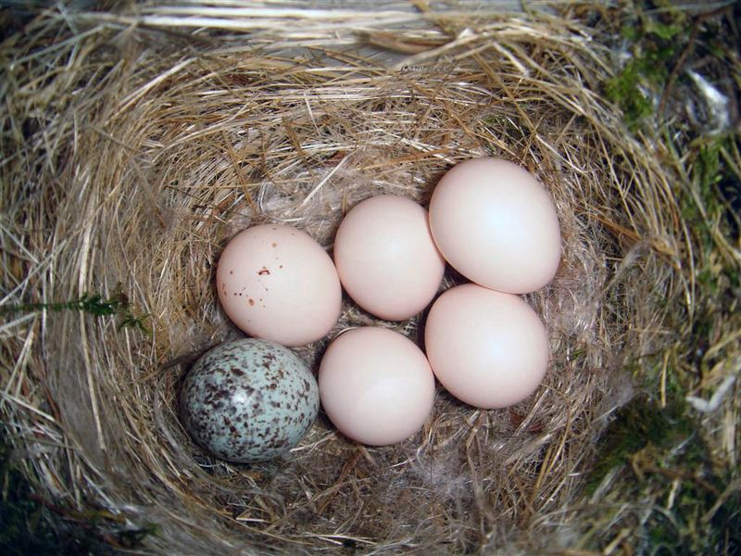
Once the birds have found partners, they find a suitable place to lay eggs.
Most birds make nests in lots of different ways.
Eggs are shaped so that they roll around in circles and do not fall off cliffs.
A cuckoo does not make its own nest. It lays its egg in the nest of another bird and leaves it for them to care for it.

Slide 4
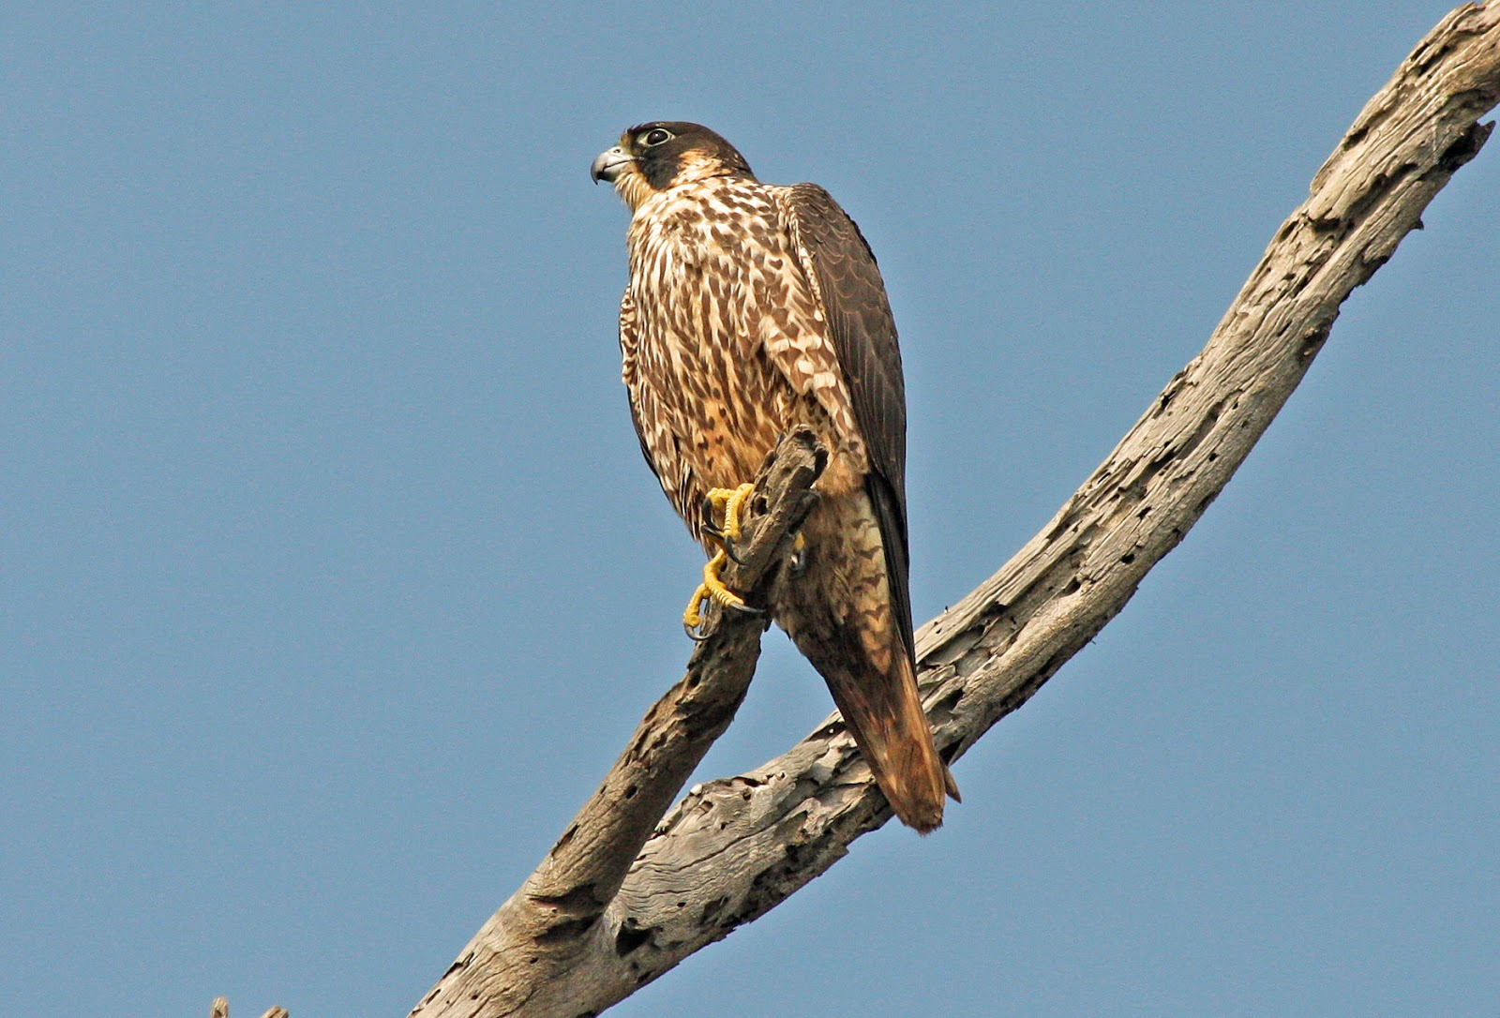
Falcons are small birds of prey with pointed wings and long tails.
Falcons eat small mammals that they hunt using eyesight and sometimes other birds.
Falcons can fly at high speed and change direction rapidly
Some falcons can dive at speeds of 320 km/h, making them the fastest-moving creatures on Earth.

