Slide 1
Jaguars
My Favourite Animal

Slide 2
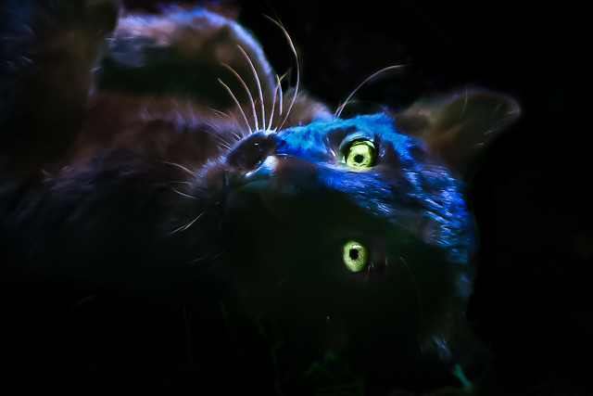
This is a baby black jaguar
This Photo by Unknown Author is licensed under CC BY-NC-ND

Slide 3
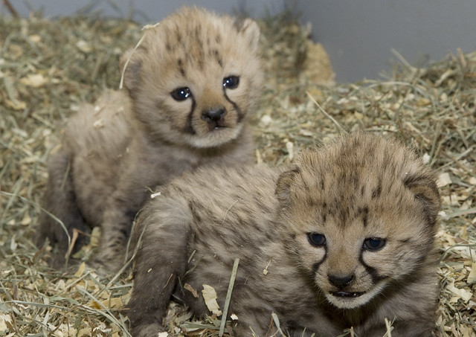
These are normal baby jaguars
This Photo by Unknown Author is licensed under CC BY-NC-ND

Slide 4
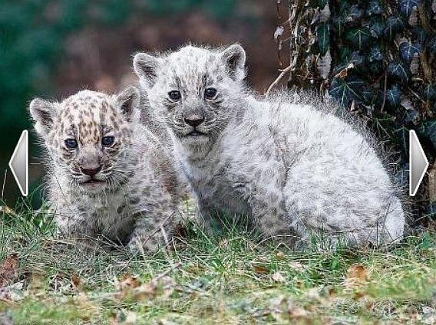
These are albino (white) baby jaguars

Slide 5
Jaguar Facts
The jaguar is the third biggest cat in the world.
Unlike many domestic cats, jaguars don’t avoid water.
A jaguar's usual call is called a 'saw' because it sounds like the sawing of wood - but with the saw only moving in one direction.

