Slide 1
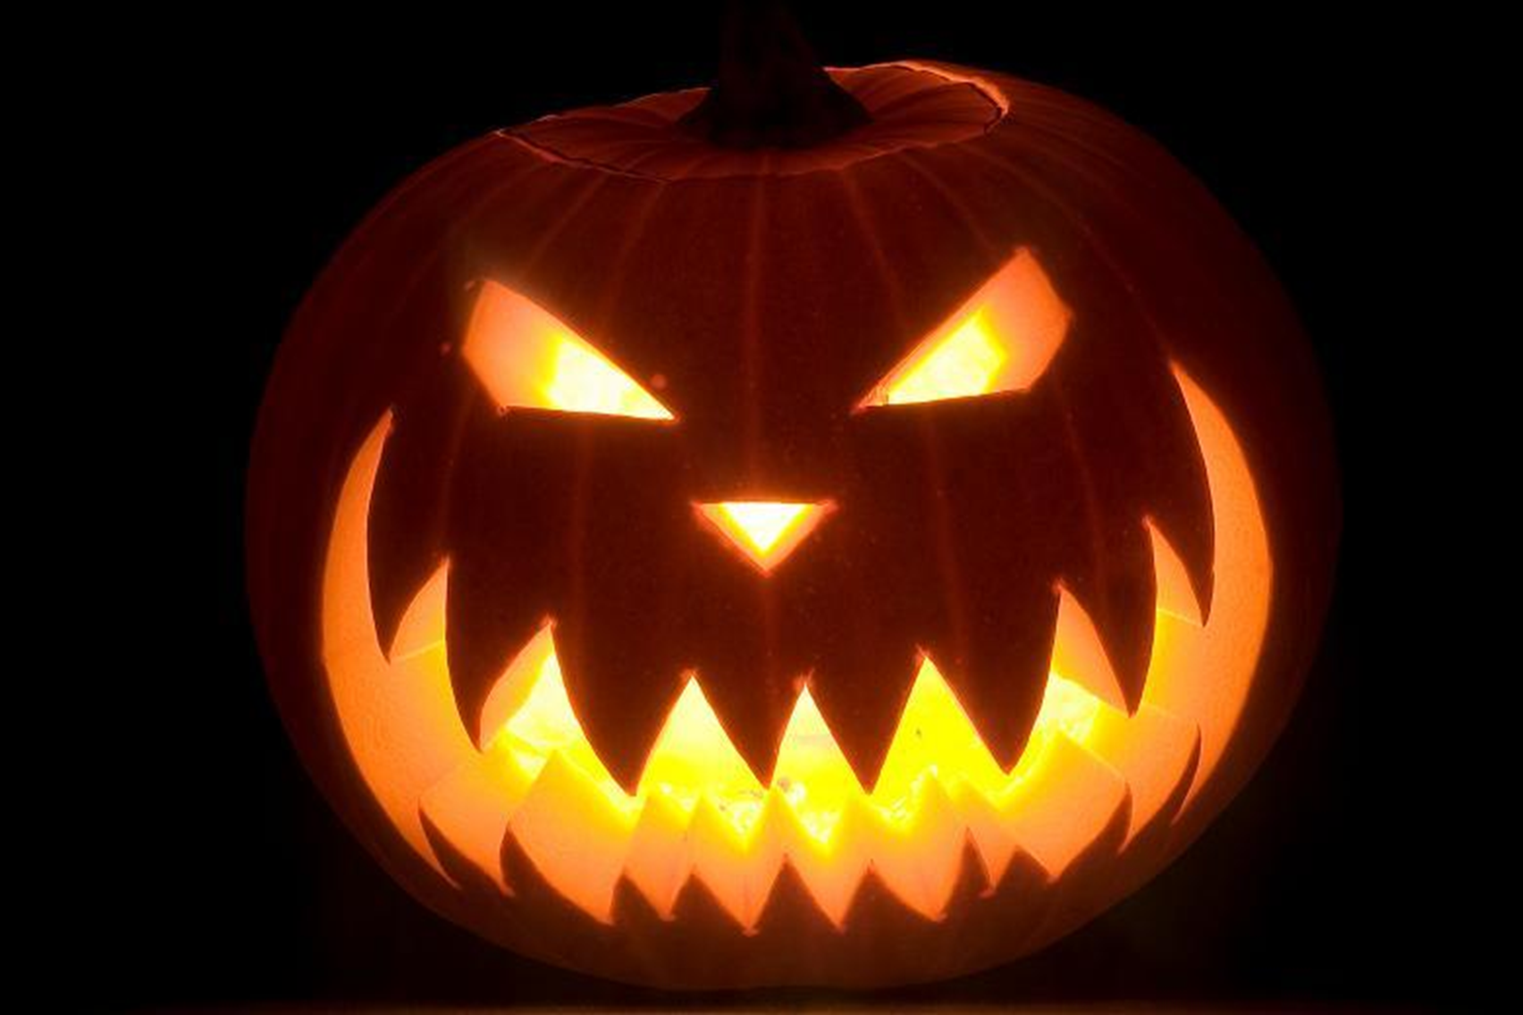
Halloween An Shamhain 31st October
Oscar Nolan

Slide 2
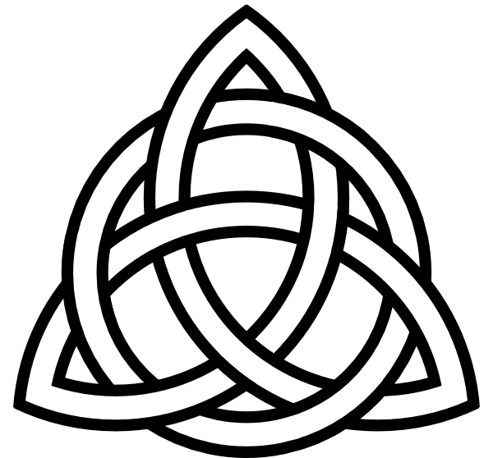
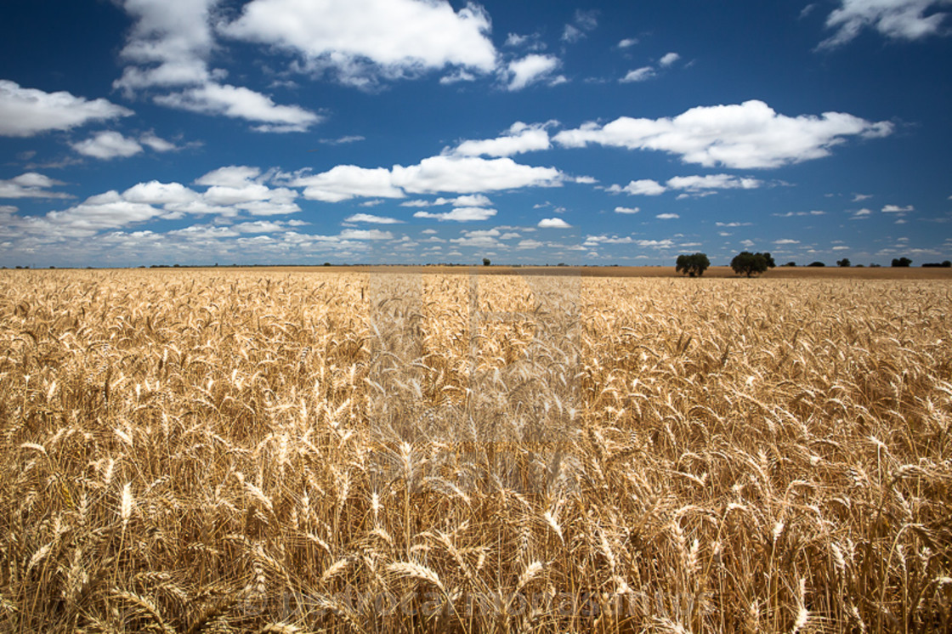
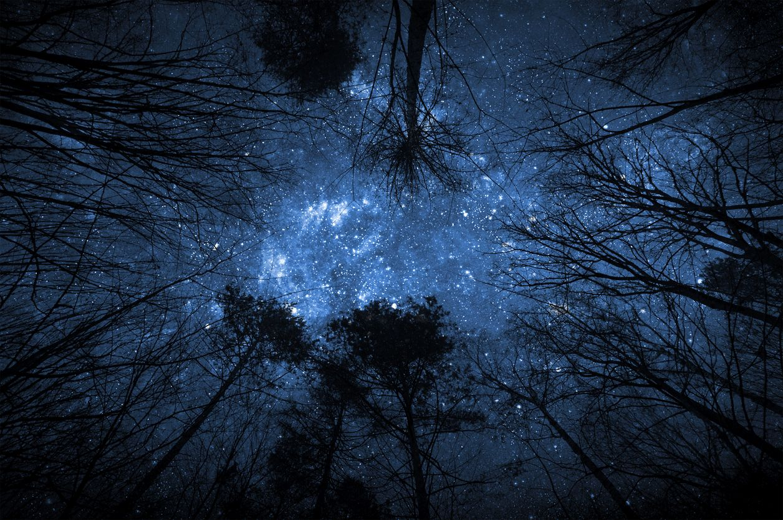
A pagan Celtic festival
The end of the harvest
The beginning of Winter

Slide 3
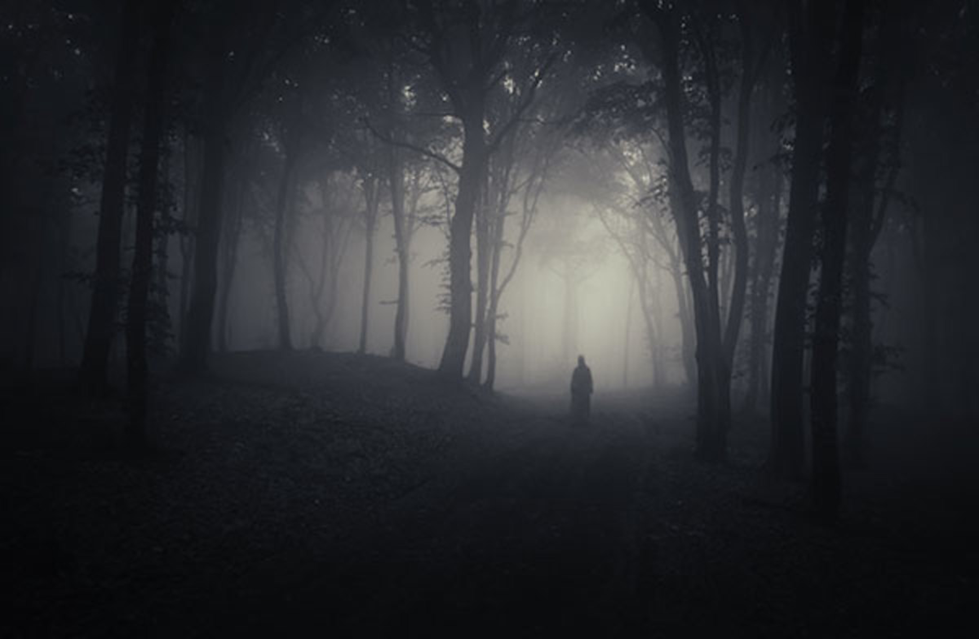
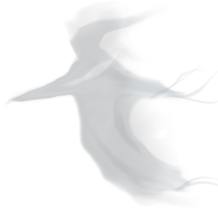
Living and Dead close together

Slide 4
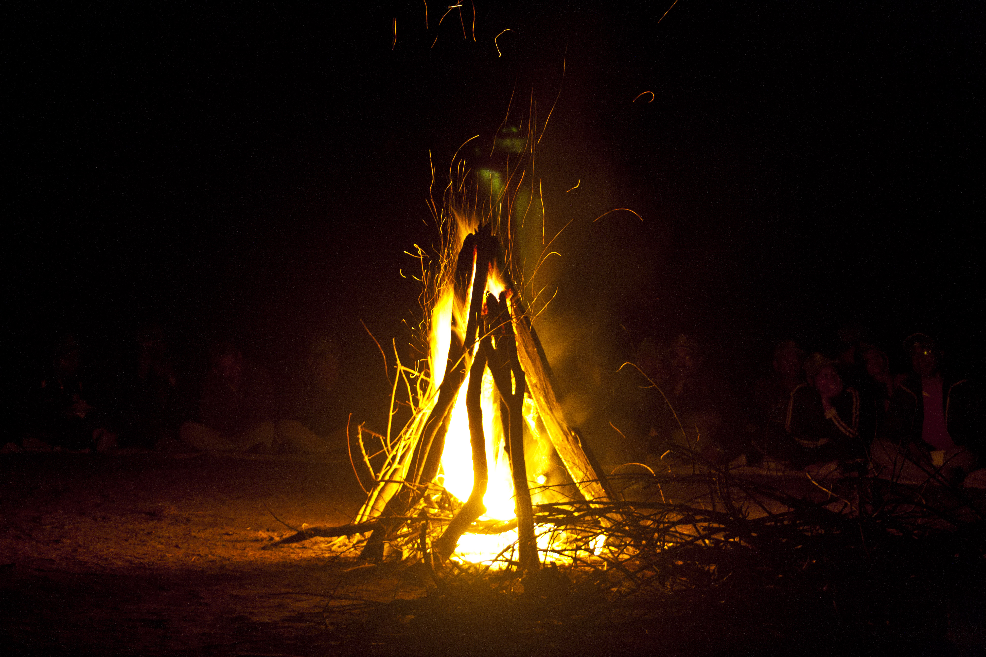
Scare away
ghosts

Slide 5
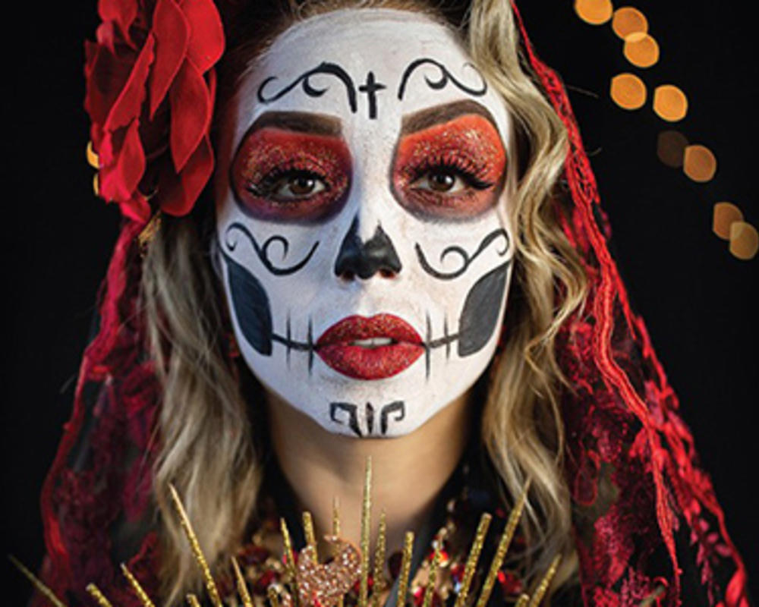
Dress up to blend in with ghosts

Slide 6
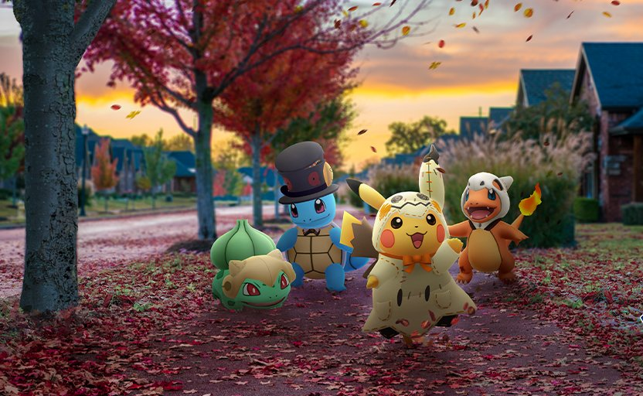
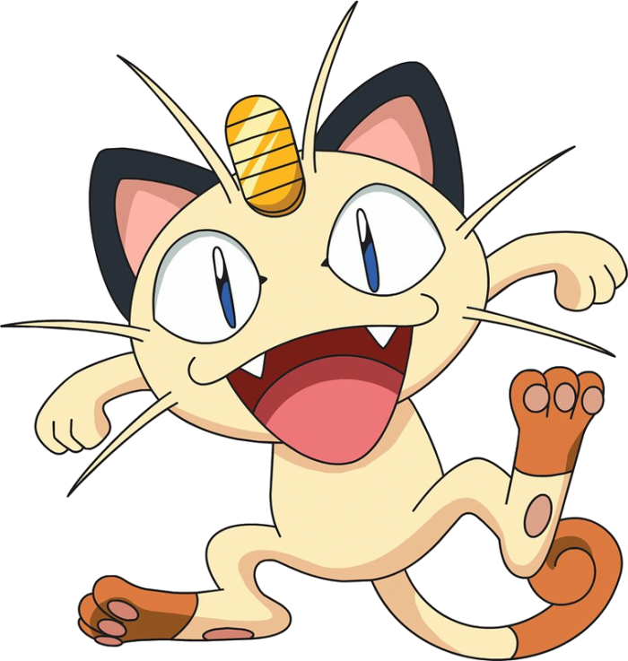
Trick or Treat!
Collect nuts and berries for ghosts to stop them playing tricks

Slide 7
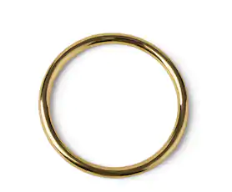
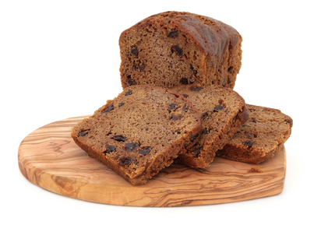
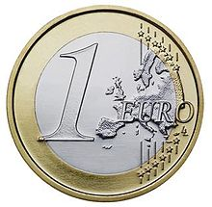
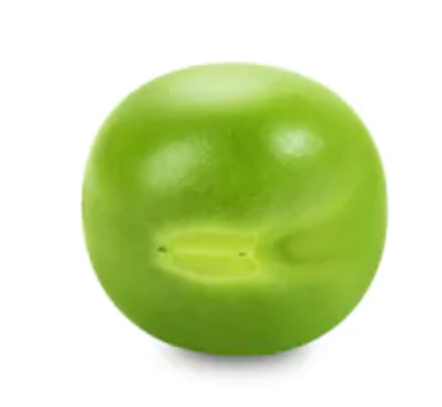
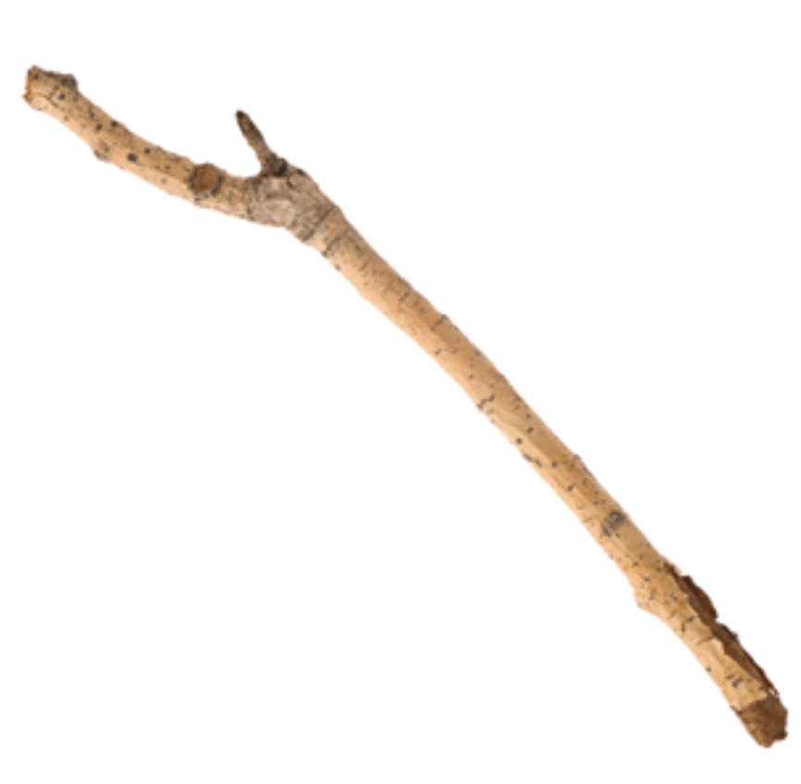
Barmbrack fortune telling game
Next to get married
Get rich !
Not married this year
Lots of arguments this year

Slide 8
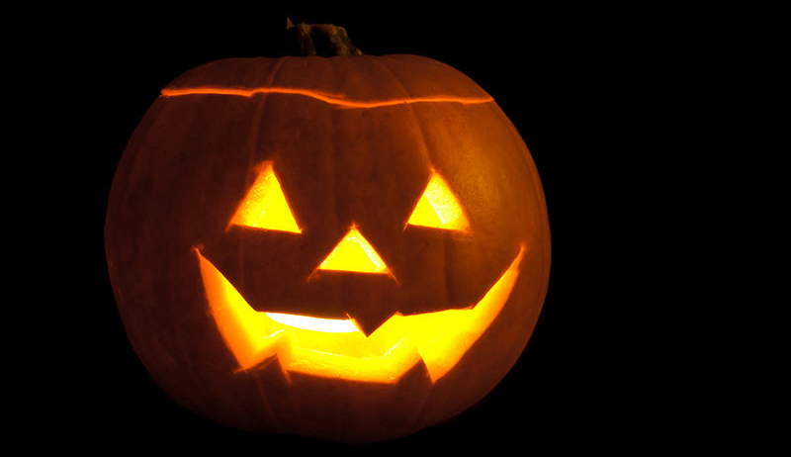
Jack O’ Lantern
An Irish Story
Jack tricks the devil
He is made to wander the land
Using a hollowed out turnip as a light

Slide 9
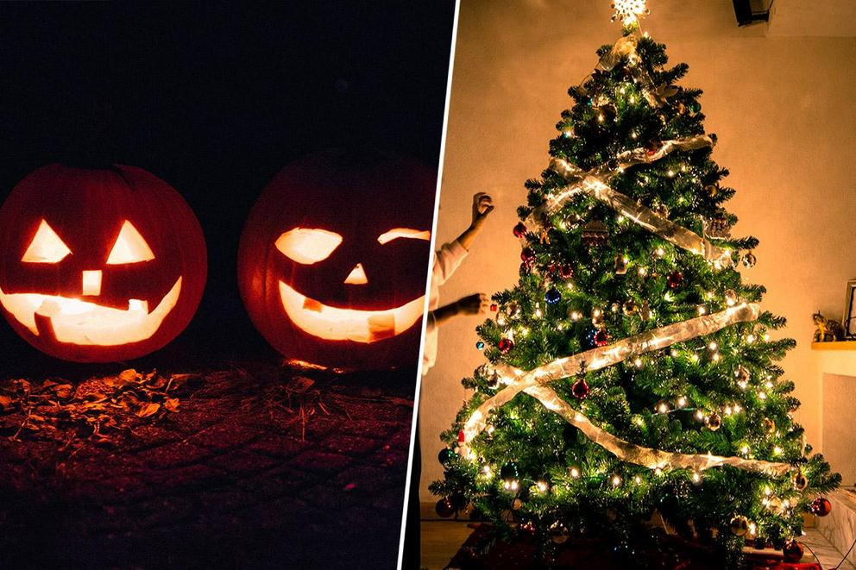
What is your favourite festival?

