Slide 1
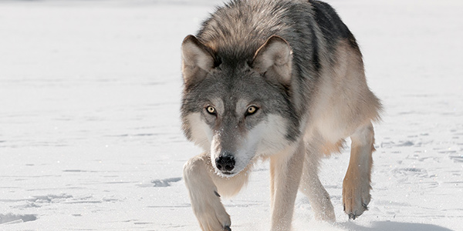
Grey wolves
By Aaron creagh

Slide 2
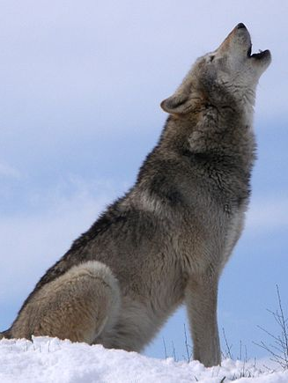
Grey wolves were once one of the most widespread animals in the world.
Grey wolves are also known as Canis Lupus and there are 250,000 grey wolves and 40 subspecies.
The smaller wolf subspecies inhabit the desert regions of the middle east and they are 26 inches and weight 45 pounds.

Slide 3
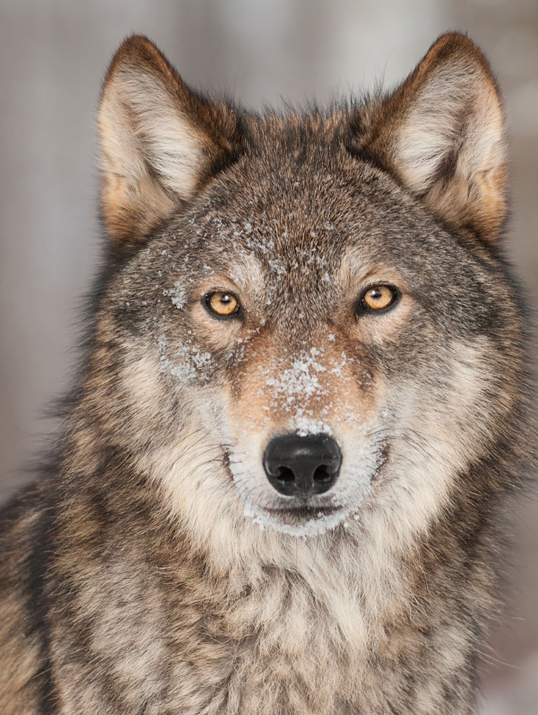
The larger wolf subspecies inhabit the northern regions of Asia and North America.
They are 36 inches to the shoulder and weight 175 pounds, making them the largest species of wild canine in the world.
Wolf packs are ruled by an alpha male and an alpha female.

Slide 4
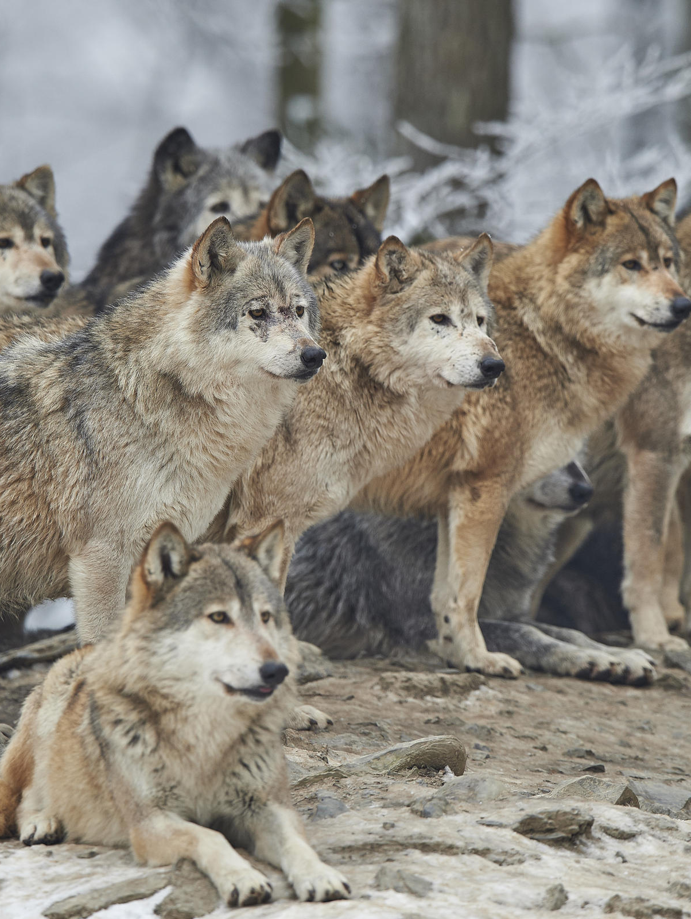
Each wolf’s howl is unique.
Humans wiped out nearly all the wolves food so they started hunting livestock which made them targets for humans.
Wolves nearly became extinct in the continental US but they were saved.

Slide 5
