Slide 1
Dolphins
by Eva Corsi

Slide 2
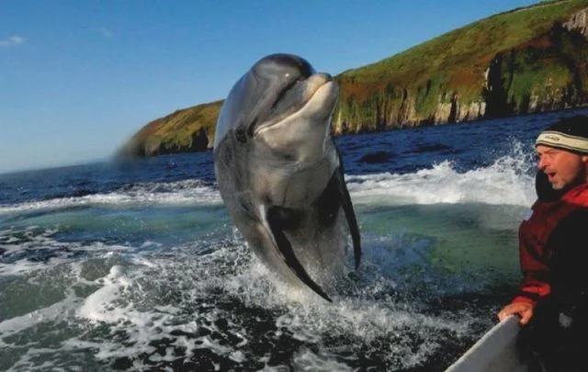
1. They are marine mammals that live in the temperate oceans, including waters off UK and Ireland.
Facts about Dolphins
FUNGIE

Slide 3
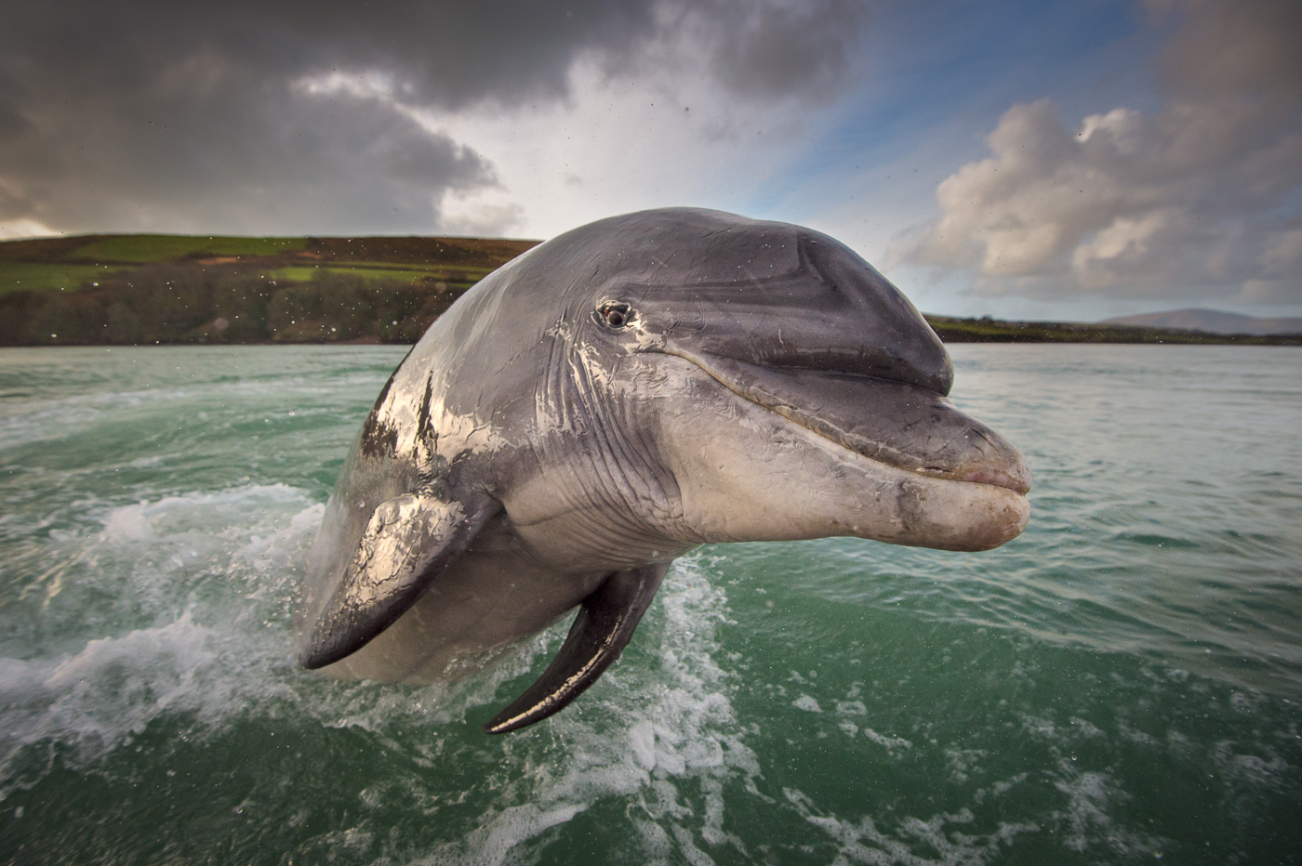
2. Dolphins are carnivores. They are grey in colour and are about 2 to 4 meters long. They have a short thick beak and a curved mouth that looks like a smile.

Slide 4
3. They are very social and live in groups, or pods, of 10-15 dolphins to help each other.

Slide 5
4. They are super swimmers and can reach speed over 30 km per hour!

Slide 6
5. They are awesome acrobats, flipping in and out the water.

Slide 7
6. They live underwater but they need to come up to the surface to breath air. They breath through the “blowhole” , a hole on the top of the head.

Slide 8
7. Dolphins are kings of communication! They squeak and whistle and also use body language, leaping out of the water, snapping their jaws and even butting heads!

Slide 9
Thank you for listening!!!

